Slide 1


Slide 2
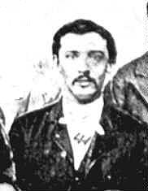

Slide 4
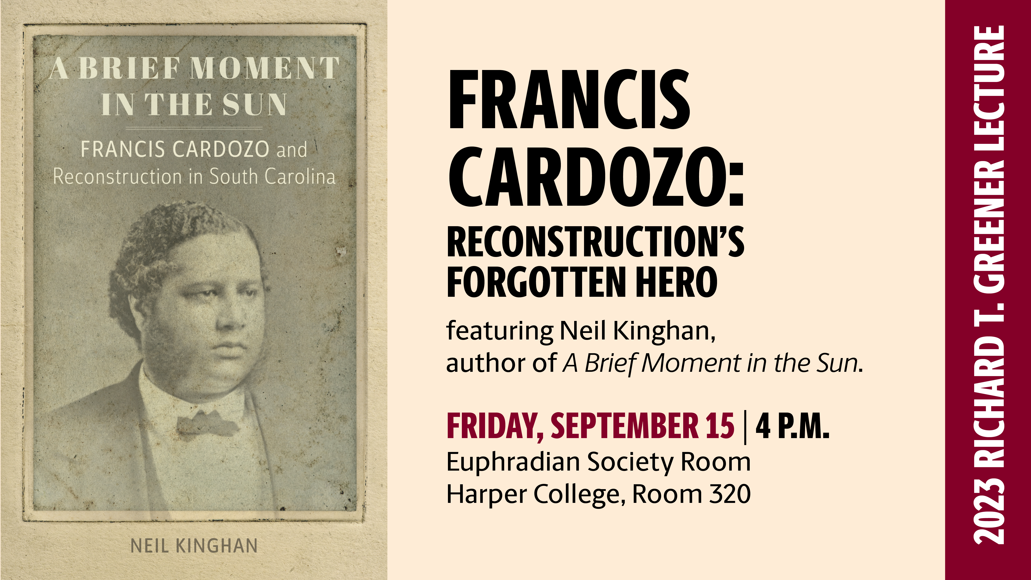

Slide 5
Christian Anderson
christian@sc.edu
Julian Williams
Julian.Williams@sc.edu

