Slide 1


Research Poster Template
SOAR Research Poster: Title of Presentation
Authors and Co-authors
University of South Carolina Floyd School of Medicine, affiliations for other authors
How to Use this Template
Your Poster Content and Presentation
Type Size and Section Headers
Highlighted box
Move Section headers around as necessary. You are not limited to the column format presented here.
Sections should include at minimum Introduction, Methods, Results and Conclusion. Many times, a Hypothesis section and an acknowledgements section are also included.
Results section should be the biggest section and should include mostly visuals like tables, charts and graphs
Copy text box to other locations on poster as needed
Poster dimensions are 44 by 36 inches.
Posters printed in the IRF can be as long or as tall as you want but ONE SIDE MUST BE NO LONGER THAN 44 INCHES
You can copy and paste from an existing presentation to the poster template or enter the information directly onto the template
Try for an even balance on your posters
Use graphs and bar charts to represent data when possible
Accent Colors: When possible, use these secondary colors when you create your charts and graphs (Brand Toolbox)
Type text inside the text boxes
Increase and decrease your view sizes as needed to see all or individual sections of poster.
Do not use a font smaller than 24 except than for captions under pictures
Make sure to keep your relevant text under the proper section headers
This box can be used to highlight a particularly important element or conclusion.
Use only one highlighted box per layout.
This work was supported by the Student Opportunities for Academic Achievement Through Research (SOAR) program which is funded by the University of South Carolina Floyd School of Medicine. [Insert other lab specific or funding acknowledgements here as well]

Slide 2
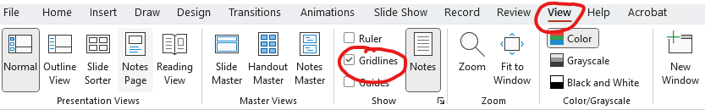
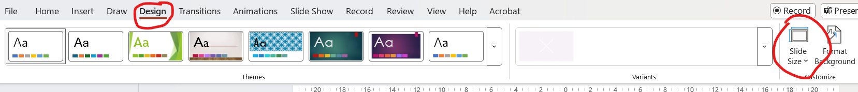
DELETE THIS SLIDE BEFORE SENDING TO PRINTING
Gridlines can help you organize your poster but if you would like to turn them off, uncheck the gridlines option.
Change slide size to the dimensions of your printed poster. When printing in the IRF one side can be no longer than 44 inches.

